Slide 1
Files mounted on the Making Strategy Sage web site
Six sets of PowerPoint slides:
  Introduction to Making Strategy
  Strategy as the Prioritisation and Management of Key Issues
  Strategy as Purpose: Agreeing Goals and Aspirations for the Organisation
  Strategy as Competitive advantage
  Closure
These slides are intended only as a supplement to the book and do not represent a complete picture of the theory, concepts, or practice that lie behind the approach to strategy. They provide some further examples and pick out some main themes.
They have been designed so that they can be modified and added to. However, the copyright of the material lies with the authors.
Four sets of PowerPoint slides that list the tasks for each of the four forums. These are directly from the book and save retyping them if required.
A 2-page quick guide to the use of Decision Explorer. This guide provides the majority of the ‘hot-key’ instructions that used extensively during the Making Strategy process.
Videos introducing the use of Decision Explorer in the issue management forum. This provides a quick way of ‘getting the hang’ of using the software at a basic level.

Slide 2
Group Explorer
There is also available a Group Support System that allows participants to enter statements and links directly in to a publicly displayed Decision Explorer model. The system also allows for the rating of statements, and the indication of preferences about, for example, options to focus on, undesirable options, leverage on goals, etc.
The significant benefits of the system are higher productivity, anonymity when appropriate, the ability to monitor development consensus, and facilitator monitoring of levels of participation and type of participation. The system has been used extensively over the past 10 years by a number of Business Schools, managers, and consultants. It has been used with top management teams of MNC’s as well as with pressure groups.
The system requires the purchase of the Group Explorer software from Ackermann&Eden at Strathclyde Business School, a full copy of Decision Explorer, Windows Server, and 2 laptop computers (one running Windows Server and the other Windows 7).
See:
Ackermann, F. and Eden, C. Negotiation in Strategy Making Teams Group Support Systems and the Process of Cognitive Change. Group Decision and Negotiation. 2011; 20(3)293-314.
Andersen, D.; Richardson, G. P.; Ackermann, F., and Eden, C. Using a Group Support System to Add Value to Group Model Building. System Dynamics Review. 2010; 26(4)335-346.

Slide 3
  Making Strategy:
  Mapping Out Strategic Success
  Chapters 5 and 6
  Strategy as Purpose:
  Agreeing Goals and Aspirations for the Organisation
  Fran Ackermann and Colin Eden

Slide 4
Please note, these slides are designed to be used in addition to the book:
Making Strategy: Mapping Out Strategic Success. by Ackermann & Eden, Sage, 2011
They are not designed to be used in a ‘stand-alone’ manner, or to replicate theory and practice presented in the book.
The assignment design represents one possibility for a 20 credit MBA course (thus each of the 4 parts represents approx 5 credits + Closure).

Slide 5
Strategic Management is about agreeing which goals to practically focus energy, cash, effort, emotion

Slide 6
Making Strategy in 4x~3hr workshops (2 days)….
Or single half day workshops
Workshop 1 – morning
  Strategy as the Prioritisation and Management of Key Issues
  Statement of Strategic Intent
Workshop 2 – afternoon
  Strategy as Purpose: Agreeing Goals and Aspirations for the Organisation
  Statement of Strategic Intent
Workshop 3 – morning
  Strategy as Competitive advantage
  Statement of Strategic Intent
Workshop 4 – afternoon
  Strategy as Stakeholder Management
  Statement of Strategic Intent
DELIVERABLE OVERALL:
  Statement of strategic intent (SSI) encompassing: issue management, purpose, competitive advantage, stakeholder management

Slide 7
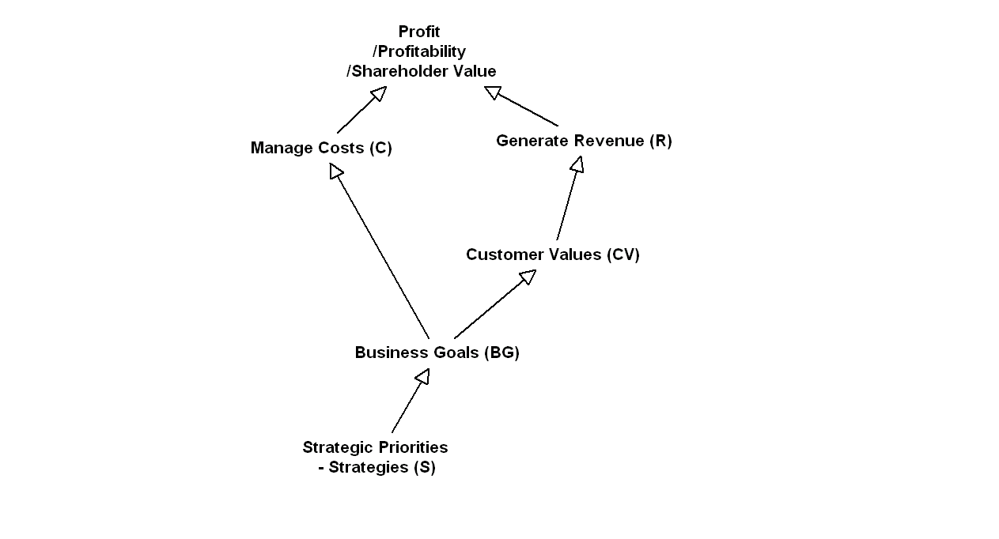
Refer to p115
The Structure of a Goals System

Slide 8
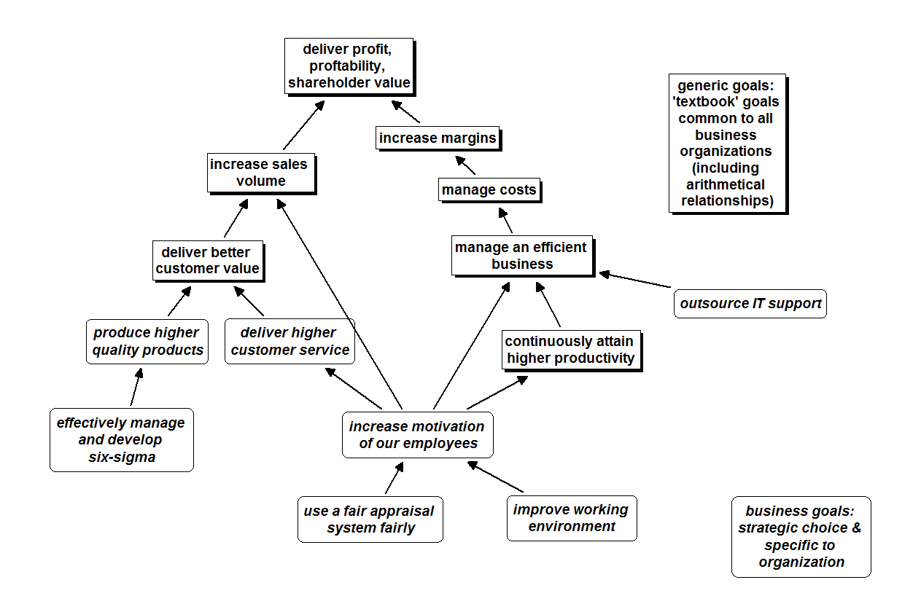
Refer to p115

Slide 10
Reverse Engineering a published goals system
Page 149-156

Slide 11
Example 1
The Royal University for Women (Bahrain)
MISSION
Offer students a rewarding and challenging multi-cultural learning environment that cultivates strong well rounded personalities, encourages leadership, and builds character, social consciousness and community.
Refer to p150

Slide 12
The Royal University for Women (Bahrain)
MISSION
Offer students a 1) rewarding and
2) challenging :multi-cultural learning environment that 3) cultivates strong well rounded personalities, 4) encourages leadership, and 5) builds character, 6) builds social consciousness and community.

Slide 13
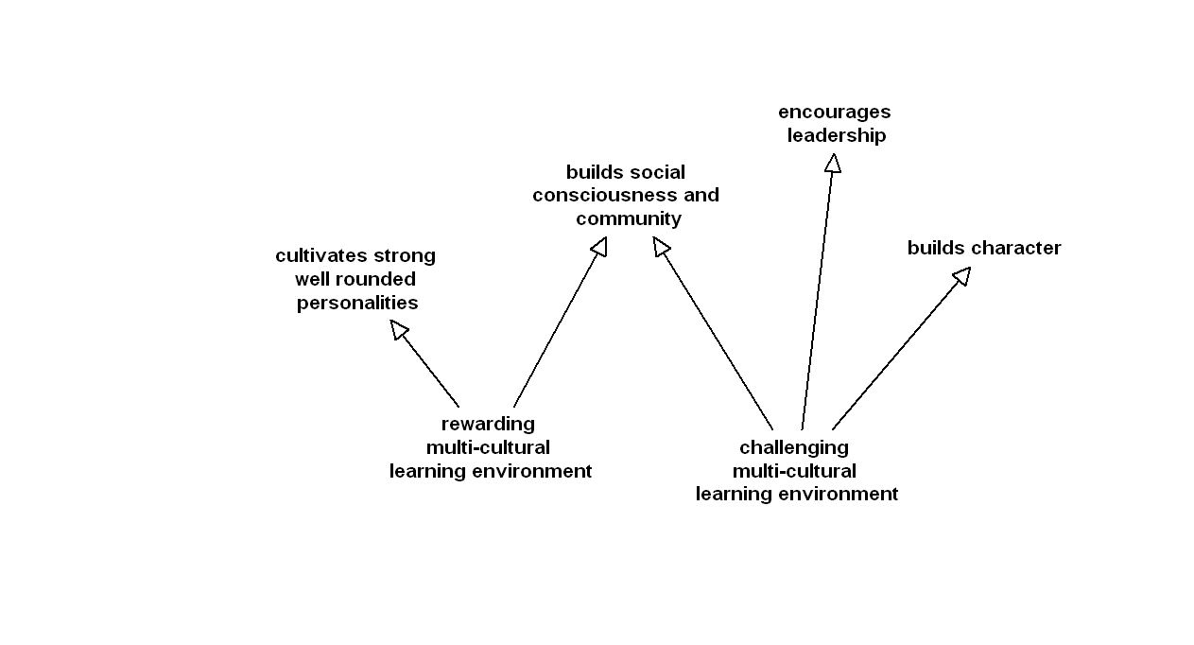
Refer to p151

Slide 14
Example 2
The vision for Glasgow Airport is simple: through sustained and sensible investment in the airport’s infrastructure and through the continuing development of a strong and lasting route network, Scotland’s busiest airport will become Europe’s most successful regional airport, supporting Glasgow, supporting Scotland, and
promoting social and economic prosperity.
In doing this, BAA Scotland willingly accepts its responsibility to local communities and we restate our commitment to long-term engagement with all airport neighbours, to ensure we remain a responsible and trusted partner in Glasgow and Renfrewshire’s future.
If Glasgow Airport is to serve Scotland well in the future, it must continue to provide first-class facilities, and this Master Plan represents a blueprint for the airport of the future.
As published on BAA Glasgow web site March 2010
Refer to p125

Slide 15
Identifying the Goals
BAA’s vision for Glasgow Airport is simple: through (1) sustained and (2) sensible investment in the airport’s infrastructure and through the (3) continuing development of a strong and lasting route network, Scotland’s busiest airport will (4) become Europe’s most successful regional
airport, (5) supporting Glasgow, (6) supporting Scotland, and (7) promoting social and economic prosperity.
In doing this, (8) BAA Scotland willingly accepts its responsibility to local communities and we restate our (9) commitment to long-term engagement with all airport neighbours, to (10) ensure we remain a responsible and trusted partner in Glasgow and Renfrewshire’s future.
If Glasgow Airport is to serve Scotland well in the future, it must (11) continue to provide first-class facilities, and this Master Plan represents a blueprint for the airport of the future.

Slide 16
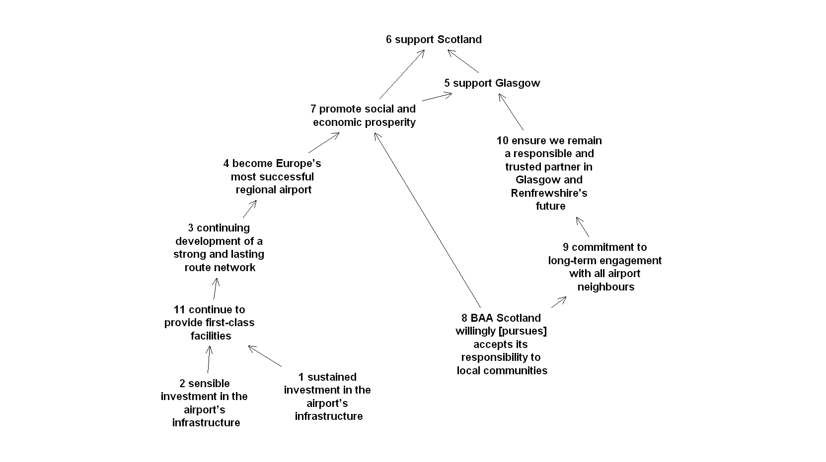
Refer to p126 and p152 for an example relating to McKinsey
BAA Glasgow – ‘reverse engineered’ vision
NOTE: causality not clearly expressed, no recognition of potential conflicts between (1) and (8)

Slide 17
Our vision
Our shared ambition for metropolitan Glasgow is of
sustained and sustainable growth in the tourism industry
as a contribution to the wealth and well-being of all.
Our vision for Glasgow 2016 is of a leading destination
in key markets offering a unique, dynamic and authentic
experience through the quality of place, product and
service differentiated through the strength of the brand,
Glasgow: Scotland with style.
Strategic Targets
to deliver a minimum growth of 60% in tourist
revenue with a target of achieving 80%
grow tourism-related employment to 40,000
increase capacity by 3,000 premier hotel bedrooms
Policy Context
Glasgow’s Tourism Strategy to 2016 takes advantage of
the favourable national policy environment, the city’s
recent economic growth and higher levels of ambition and
aspiration for Glasgow’s future prosperity and well-being.
The strategy is closely aligned to key national and city
policy documents.
Scottish Tourism: The Next Decade – A Tourism Framework
For Change takes a similar long-term approach to tourism
development and sets ambitious targets. As Scotland’s
largest city, and a successful urban destination, Glasgow
has an important part to play in contributing to national
targets through its business and short break tourism
markets. The strategy reflects principal policy initiatives,
including the importance of cities in regional development.
In line with the city’s economic development strategy,
A Step Change for Glasgow, the key objective is to maximise
economic growth for the benefit of Glasgow’s citizens,
while at the same time creating a more attractive
environment for visitors and investors. The strategy
complements Glasgow City Council’s key objectives and
agenda for social renewal. It also embraces Scottish
Enterprise’s tourism priorities of innovation, product
development, business leadership development, and
destination development. The approach to delivery seeks
to reflect the relationship between the city and the wider
region, in particular the strengthening links with Edinburgh via closer collaboration.
Ten year priorities
To achieve the vision for tourism, four key priorities have
emerged from a process of research and consultation
with stakeholders and industry representatives.
Not only do they represent the main pillars around
which the strategy and subsequent action plans will be
developed, but they complement and support the broad
themes within Glasgow’s economic development strategy.
The four strategic themes are:
1. Image and Brand: a positive and unique image is a
key influencer.
2. People: Glasgow’s citizens are the city’s greatest
asset and must benefit from tourism’s growth.
3. Place: place attractiveness, accessibility and
quality of environment are competitive drivers for a
successful tourism destination.
4. Product: this must be fresh, distinctive, innovative
and appealing to target markets.
These four themes will be underpinned by the
cross-cutting themes of sustainability, innovation, collaboration and market research.
Strategic Ambition
Glasgow will be recognised as a leading global tourism
destination with delivery driven through a city-wide
partnership of organisations, institutions and businesses
committed to this single vision.
Extracted from web site March 2010
Example 3

Slide 18
Try it…
Reverse Engineer the published goals for Glasgow

Slide 19
Our vision
Our shared ambition for metropolitan Glasgow is of
sustained and sustainable growth in the tourism industry
as a contribution to the wealth and well-being of all.
Our vision for Glasgow 2016 is of a leading destination
in key markets offering a unique, dynamic and authentic
experience through the quality of place, product and
service differentiated through the strength of the brand,
Glasgow: Scotland with style.
Strategic Targets
to deliver a minimum growth of 60% in tourist
revenue with a target of achieving 80%
grow tourism-related employment to 40,000
increase capacity by 3,000 premier hotel bedrooms
Policy Context
Glasgow’s Tourism Strategy to 2016 takes advantage of
the favourable national policy environment, the city’s
recent economic growth and higher levels of ambition and
aspiration for Glasgow’s future prosperity and well-being.
The strategy is closely aligned to key national and city
policy documents.
Scottish Tourism: The Next Decade – A Tourism Framework
For Change takes a similar long-term approach to tourism
development and sets ambitious targets. As Scotland’s
largest city, and a successful urban destination, Glasgow
has an important part to play in contributing to national
targets through its business and short break tourism
markets. The strategy reflects principal policy initiatives,
including the importance of cities in regional development.
In line with the city’s economic development strategy,
A Step Change for Glasgow, the key objective is to maximise
economic growth for the benefit of Glasgow’s citizens,
while at the same time creating a more attractive
environment for visitors and investors. The strategy
complements Glasgow City Council’s key objectives and
agenda for social renewal. It also embraces Scottish
Enterprise’s tourism priorities of innovation, product
development, business leadership development, and
destination development. The approach to delivery seeks
to reflect the relationship between the city and the wider
region, in particular the strengthening links with Edinburgh via closer collaboration.
Ten year priorities
To achieve the vision for tourism, four key priorities have
emerged from a process of research and consultation
with stakeholders and industry representatives.
Not only do they represent the main pillars around
which the strategy and subsequent action plans will be
developed, but they complement and support the broad
themes within Glasgow’s economic development strategy.
The four strategic themes are:
1. Image and Brand: a positive and unique image is a
key influencer.
2. People: Glasgow’s citizens are the city’s greatest
asset and must benefit from tourism’s growth.
3. Place: place attractiveness, accessibility and
quality of environment are competitive drivers for a
successful tourism destination.
4. Product: this must be fresh, distinctive, innovative
and appealing to target markets.
These four themes will be underpinned by the
cross-cutting themes of sustainability, innovation, collaboration and market research.
Strategic Ambition
Glasgow will be recognised as a leading global tourism
destination with delivery driven through a city-wide
partnership of organisations, institutions and businesses
committed to this single vision.
Extracted from web site March 2010
Example 3

Slide 20
Our vision
Our shared ambition for metropolitan Glasgow is of
(1) sustained and sustainable growth in the tourism industry
as a (2) contribution to the wealth and well-being of all.
Our vision for Glasgow 2016 is of a (3) leading destination
in key markets (4) offering a unique, dynamic and authentic
experience through the (5) quality of place, product and
service differentiated through the strength of the brand,
Glasgow: Scotland with style.
Strategic Targets
to (6) deliver a minimum growth of 60% in tourist
revenue with a target of achieving (7) 80%
grow tourism-related employment to 40,000
(8) increase capacity by 3,000 premier hotel bedrooms
Policy Context
Glasgow’s Tourism Strategy to 2016 (9) takes advantage of
the favourable national policy environment, the city’s
(10) recent economic growth and (11) higher levels of ambition and
aspiration for Glasgow’s future prosperity and well-being.
The strategy is closely aligned to key national and city
policy documents.
Scottish Tourism: The Next Decade – A Tourism Framework
For Change takes a similar long-term approach to tourism
development and sets ambitious targets. As Scotland’s
largest city, and a successful urban destination, Glasgow
has an important part to play in (12) contributing to national
targets through its (13) business and short break tourism
markets. The strategy reflects principal policy initiatives,
including the importance of cities in regional development.
In line with the city’s economic development strategy,
A Step Change for Glasgow, the key objective is to (14) maximise
economic growth for the benefit of Glasgow’s citizens,
while at the same time (15) creating a more attractive
environment for visitors and investors. The strategy
(16) complements Glasgow City Council’s key objectives and
agenda for social renewal. It also embraces Scottish
Enterprise’s tourism priorities of innovation, product
development, business leadership development, and
destination development. The approach to delivery seeks
to reflect the relationship between the city and the wider
region, in particular the strengthening links with Edinburgh
via closer collaboration.
Ten year priorities
To achieve the vision for tourism, four key priorities have
emerged from a process of research and consultation
with stakeholders and industry representatives.
Not only do they represent the main pillars around
which the strategy and subsequent action plans will be
developed, but they complement and support the broad
themes within Glasgow’s economic development strategy.
The four strategic themes are:
1. Image and Brand: a (17) positive and unique image is a key influencer.
2. People: (18) Glasgow’s citizens are the city’s greatest asset and must benefit from tourism’s growth.
3. Place: (19) place attractiveness, accessibility and
quality of environment are competitive drivers for a
successful tourism destination.
4. Product: this must be (20) fresh, distinctive, innovative and appealing to target markets.
These four themes will be underpinned by the
cross-cutting themes of sustainability, innovation, collaboration and market research.
Strategic Ambition
Glasgow will be recognised as a leading global tourism
destination with delivery driven through a city-wide
partnership of organisations, institutions and businesses
committed to this single vision.

Slide 21
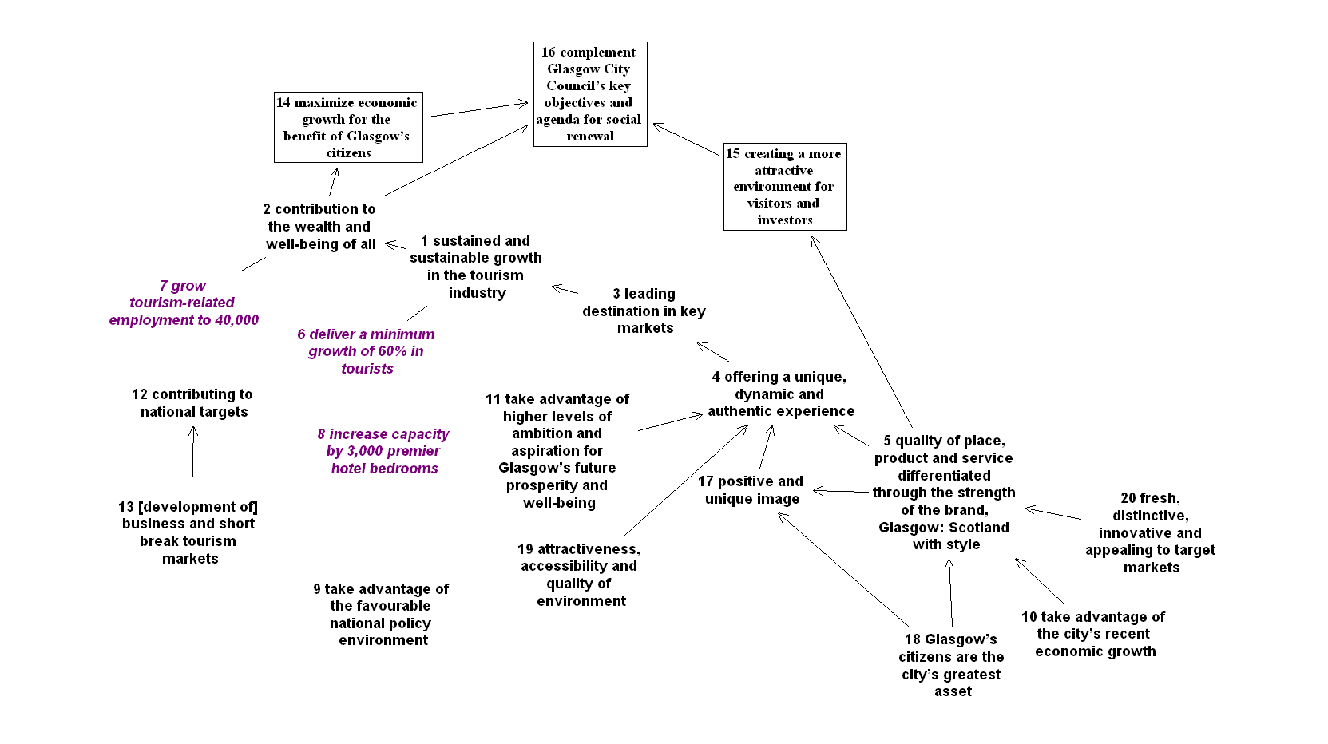
City of Glasgow tourism strategy – ‘reverse engineered’
KEY: boxed are ‘not-goals’; italics are KPI’s; other are goals (?)
Note: complex expression of goals and difficulty in discerning means-ends

Slide 22
The timing…
Time elapsed 00:40/01:10
  Reverse engineering a mission/vision/goals/purpose statement (40-70mins)
  [But might take you longer… this is your first attempt!]

Slide 24
Creating a Goals System: Starting ‘from Scratch’
Page 156-160

Slide 25
STARTING QUESTION: "what should be the purpose of the organisation for the next x years?"
Refer to p156
The payoff from this forum is
  i) the construction of a goals system - a pattern of interacting goals set out as a network, and
  ii) the crafting of appropriate aspirational wording that enables the system to make sense -- that is, ensuring that the meaning of any one goal satisfactorily relates to the other goals of that helped deliver it, and the other goals that it helps deliver.
In addition, there is likely to be significant organizational learning & team building that derives from building a goals system together so that members of a management team show themselves how different parts of the organization fit together and are systemically dependent on each other.

Slide 26
Round-Robin: Suggested goals for an Institute for Science (note that the reference numbering from Decision Explorer implies that some suggested goals were merged with others and some deleted)
9 increase income from non-public funded research visitors
10 exchange of staff
11 research collaboration
12 enhance our profile
13 enhanced reputation of the Science grouping within the Institute
14 make us more recognised around the world
15 increase revenue
16 raise more income from collaborative opportunities,
19 enhance reputation in the World
21 create community of scholars drawn from UK and abroad
22 increase profile of work done at the Institute
23 flexible and reliable source of income
24 knowledge exchange opportunities
25 research papers with overseas partners
27 enhance experience of our staff
28 gain a more international outlook
30 research staff exchange possibilities
31 create strategic alliances
32 become more competitive
33 tap into capacities (hardware) /themes that we have not thought of
35 enhance the research exchange possibilities
36 lose best research staff to linked institutes
37 learn from other institutions
53 gain joint funding with o/s partners
54 identify our research strengths
55 attract and recruit more international research staff
56 identify research needs
57 horizon scanning of funding opportunities
58 wider range of topics with o/s partners
63 build upon existing international links
Example
Refer to p129

Slide 27
Candidate goals after reduction by elimination of those statements now later regarded as strategies not goals
9 increase income from non-public funded research visitors
10 exchange of staff
11 generate more research collaborations
12 enhance our profile
13 enhanced reputation of the Science grouping within the Institute
14 enhance reputation in the World and make us more recognised around the world
15 increase revenue
16 raise more income from collaborative opportunities
21 create community of scholars drawn from UK and abroad
22 increase profile of work done at the Institute
23 deliver a more flexible and reliable source of income
24 create knowledge exchange opportunities
25 publish research papers with overseas partners
27 enhance experience of our staff
28 gain a more international outlook
31 create strategic alliances
32 become more competitive
33 tap into capacities (hardware) /themes that we have not thought of
35 enhance the research exchange possibilities
36 AVOID losing best research staff to linked institutes
37 learn from other institutions
55 attract and recruit more international research staff
Example
Refer to p130

Slide 28
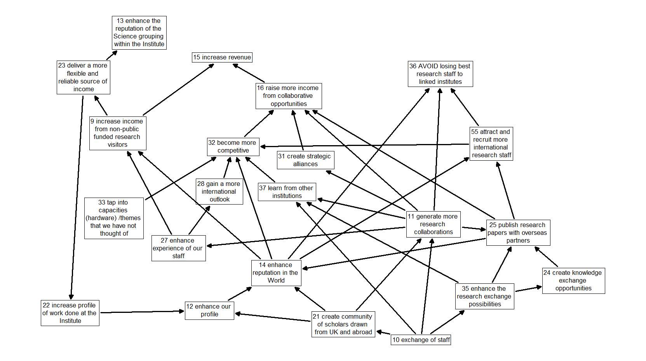
Example
Refer to p131
First attempt at a Goals System

Slide 29
Try it…
From scratch, develop and explore a goals system for your own organisation, or for yourself….

Slide 30
The timing…
Time elapsed 00:35/01:00
  Developing a goals system from scratch (35-60mins)
  Although this forum can take a half day when appropriate – the above timings are for a ‘quick and crude’ attempt

Slide 32
Strategy Making Workshop Strategic issues to emergent goals
Page 161-168
Detecting EMERGENT STRATEGIZING
An “Issue” implies goals/objectives

Slide 33
“The crucial activities for decision making are not separate episodes of analysis. Instead, they are actions, whose controlled execution consolidates fragments of policy that are lying around, gives them direction, and closes off other possible arrangements"
Karl Weick 1983
"Strategies need not be deliberate - they can also emerge"
Mintzberg, Crafting Strategy, 1987
"Emergent strategy means, literally, unintended order" "Strategy as pattern in action"
Mintzberg, Perspectives on Strategic Management
"Policy making is typically a never ending process of successive steps in which continual nibbling is a substitute for a good bite"
Lindblom, The Policy Making Process, 1968
"Changes in degree lead to changes in kind"
Karl Marx
Detecting EMERGENT STRATEGIZING
An “Issue” implies goals/objectives

Slide 34
Building the Emergent Goals System
Refer to p162
Take one of the high priority issues and track up to a ‘head’ then…
Ask:
  “what might happen, that’s undesirable, if we don’t address it?” or alternatively:
  “what we achieve if we were to find an effective way of addressing the issue?”

Slide 35
Building the Emergent Goals System
Take the highest priority issue and
Ask:
  “what might happen, that’s undesirable, if we don’t address it?” or alternatively:
  “what we achieve if we were to find an effective way of addressing the issue?”
And then ask the same question of that answer, and so on, until the answer given is a goal or negative-goal (an obviously bad achievement/ outcome for the organization)

Slide 36
Building the Emergent Goals System
Take another of the highest priority issues and track up to a ‘head’ then…
Ask:
  “what might happen, that’s undesirable, if we don’t address it?” or alternatively:
  “what we achieve if we were to find an effective way of addressing the issue?”

Slide 37
Refer to p170
Increase market share
Generic Goals
Provide exceptional service response
Business Goals
(specific to your organization)
[Avoid] too slow response times for crane breakdowns
Priority Issues

Slide 38
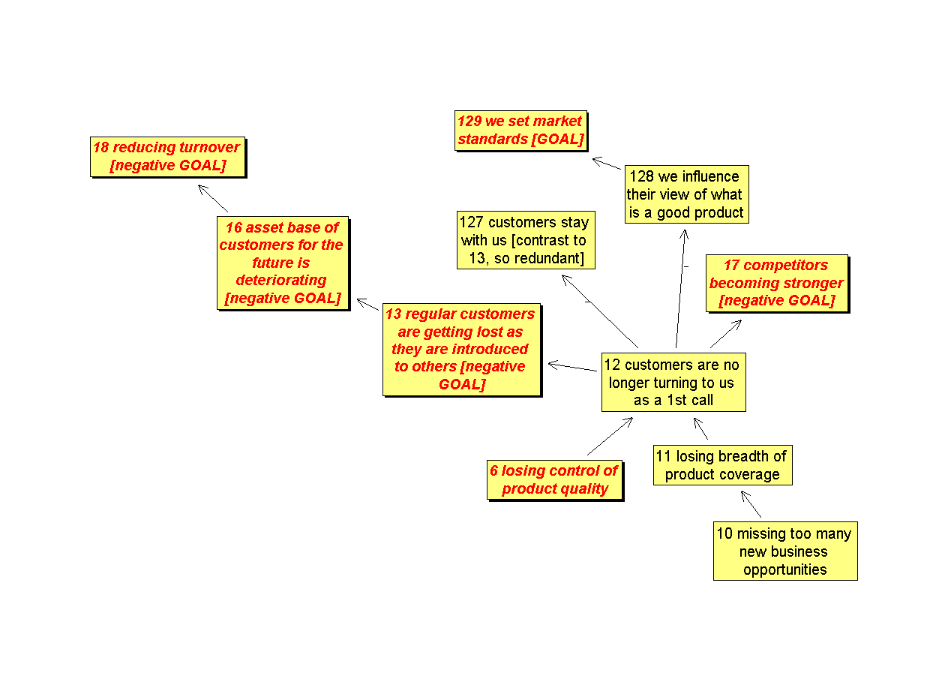
Working to avoid ‘duplication’
Refer to p164
Example of redundant and appropriate laddering up
127 and 13 are simply opposites and so should be contrasting poles in a single statement!

Slide 39
Try it…
Target: ladder up from at least 2 high priority issues [in Strategy as Issue Management these will be *** issues]

Slide 40
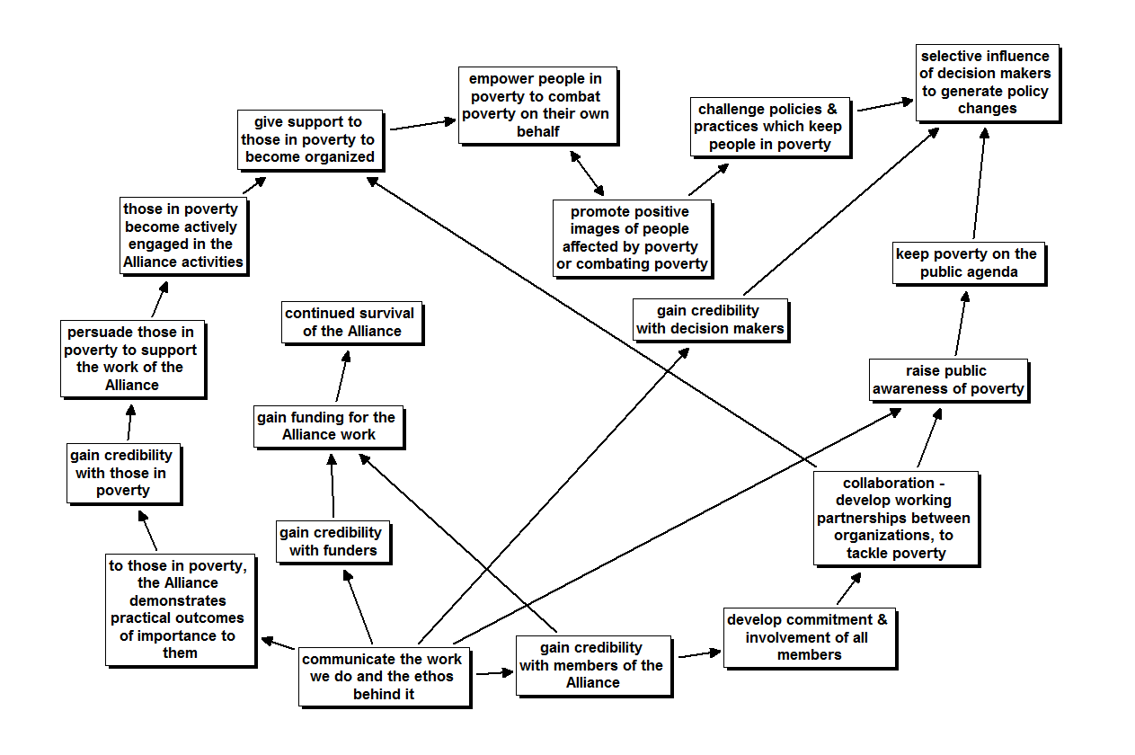
Refer to p123
The First Draft of an Emergent Goals System

Slide 41
Try it…
Target: minimum of laddering from all top priority [***] issues, then add in ‘published’/ intended goals and link all into a goals SYSTEM

Slide 42
The timing…
Time elapsed 00:50/01:40
  Developing the emergent goals system (50-100mins)
  The above timings are based on an “80:20” Pareto basis where most goals can be elicited in these times.

Slide 44
Refining the goals system…
Page 168-end of chapter

Slide 45
Compare emergent goals, published (reverse engineered) goals, and goals from scratch

Slide 46
Elaborating the Goals System
Show all of the goals and negative goals and place on a separate view in DE – and “>map goal” (where “goal” is the style or set representing all goals)
Refer to p168

Slide 47
Elaborating the Goals System
Examine each of the negative goals in order to make them more aspirational
  Try putting NOT or AVOID in front of the statement as a starting point
Refer to p166

Slide 48
Elaborating the Goals System
Check whether there are any further links between goals and whether the goals are worded in an suitably aspirational manner
Check for ‘missing’ goals
‘Highlight’ goals that are discomforting for the future of the organization: do not DELETE but note that they do not represent the future goals of the organisation – and so ‘deleting’ them will demand significant organisational change
Refer to p168

Slide 49
‘SMART’ Goals are rarely helpful!
Specific [Understandable]
Measurable [KPI’s inc qualitative]
Attainable [Aspirational]
Realistic
Timely
Dangers of acronyms…
Alternatively the Key test: does the Goal System describe a distinctive sense of purpose and a framework for strategic decision making?
Refer to p120

Slide 50
Remember…
“Everything that can be counted does not necessarily count; everything that counts cannot necessarily be counted”
Albert Einstein (1879-1955)
Refer to p140

Slide 51
Try it…
Target: create a sensible first draft goals system map on a separate DE view

Slide 52
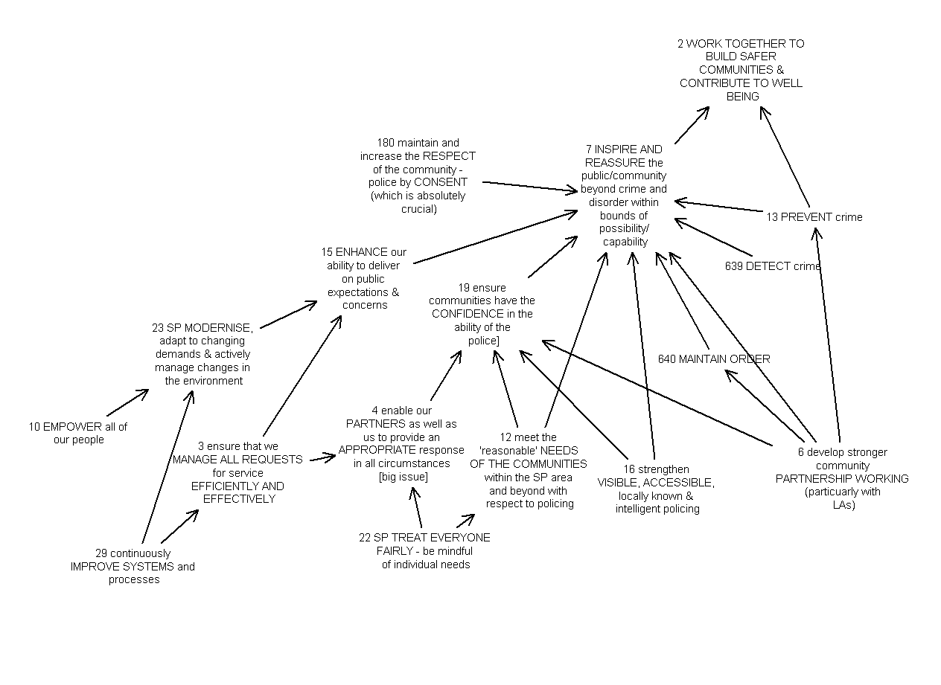
Developing SSI Text from a Map
Refer to p135 for process
and another example
An Example Goal System for a Police Force in the UK

Slide 53
Developing a Goals SSI Text from a Map: first step
Draft Statement of Objectives (Strategic Intent)
We will WORK TOGETHER TO BUILD SAFER COMMUNITIES
By
PREVENT crime; DETECT crime; MAINTAIN ORDER; ensure communities have CONFIDENCE; ENHANCE delivery AND gain RESPECT – police BY CONSENT
We will gain CONFIDENCE
By
Provide APPROPRIATE responses; meet NEEDS OF THE COMMUNITIES; strengthen VISIBLE ACCESSIBLE policing, and develop PARTNERSHIP WORKING.
And we will MAINTAIN ORDER AND PREVENT crime through PARTNERSHIP WORKING
Provide APPROPRIATE response
By
TREAT EVERYONE FAIRLY; MANAGE ALL REQUESTS EFFICIENTLY AND EFFECTIVELY
ENHANCE delivery
By
MODERNISE;
By
IMPROVE SYSTEMS
However,
WORKing TOGETHER TO BUILD SAFER COMMUNITIES
Will be aided by
become the LEADER; gain PROFESSIONAL RECOGNITION; seen as a MODEL, CONTRIBUTE TO NATIONAL PRIORITIES
To become the LEADER
By
INNOVATIVE through EMPOWER; MODERNISE through IMPROVE SYSTEMS, SECURE BEST VALUE through MANAGE ALL REQUESTS EFFICIENTLY AND EFFECTIVELY; HIGH CALIBRE through HIGH MORALE

Slide 54
Developing SSI Text from a Map: second step
Note minimum connecting text at this stage
We will WORK TOGETHER TO BUILD SAFER COMMUNITIES and CONTRIBUTE TO THE WELL-BEING of our citizens.
By preventing crime, and inspiring and reassuring the public/community beyond [managing] crime and disorder within the bounds of possibility/capability.
We will inspire and reassure by detecting crime; maintaining order; and ensuring communities have confidence in the abilities of the Police; by strengthening visible, accessible, locally known and visible policing and meeting the ‘reasonable’ needs of the communities within the Strathclyde Police area and beyond with respect to policing.
We will also inspire and reassure by enhancing our ability to deliver on public expectations and concerns and maintaining the respect of the community – policing by consent (which is absolutely crucial).
We will ensure communities have confidence in the abilities of the Police by developing stronger community partnership working (particularly with respect to Local Authorities). This will also help inspire and reassure the public/community and achieve the maintenance of order and prevention of crime.
We will also ensure communities have confidence in the abilities of the Police by enabling our partners as well as us to provide an appropriate response in all circumstances by treating everyone fairly and being mindful of individual needs, which contribute to our meeting the ‘reasonable’ needs of the communities.
We shall strive to enhance our ability to deliver on public expectations and concerns by ensuring we manage all requests for service efficiently and effectively and modernising, adapting to changing demands and actively managing changes in the environment.
We will do this by empowering all of our people and continuously improving systems and processes.

Slide 55
Assignment: Part 2
Refer to assignment details slides
Save DE model
  File name= ‘group name’_PU
Write and Save SSI
Write Reflections piece

